Slide 1

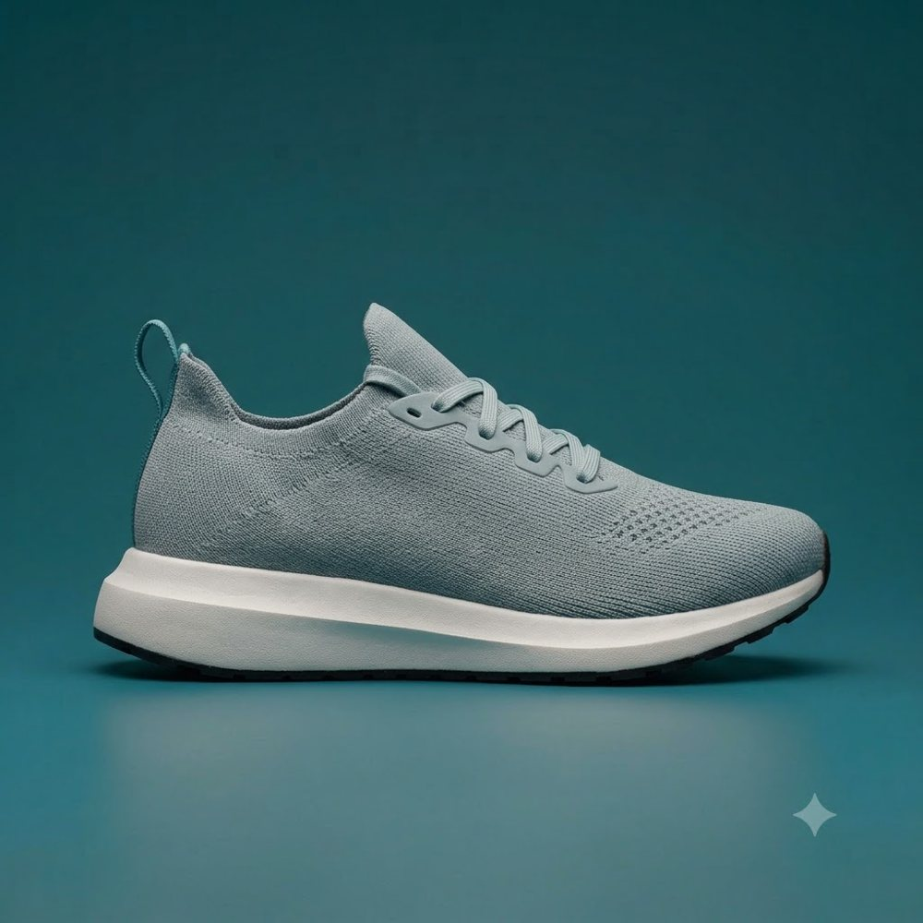
SUPER AUDIENCE · MARKETING PLAN
Sneaker Buyers —
Active Purchasers
28.4%
of the national file
One seven-word request became a scored national audience and a ready-to-present marketing plan — delivered together.
Generated by Intelafy from measured data. Illustrative example; company and figures anonymized.

Slide 2

STEP 1 · THE AUDIENCE
A finished audience — measured, not guessed.
Athletic shoes
28.4%
Purchased in last 12 months
of the national file
Total buyers
Sized from actual buying behavior
✓
✓
✓
Scored on the 0–1 scale
Ready to segment
Ready to combine
The engine confirmed no sneaker audience existed yet, focused on how recently people bought, and returned a finished, ready-to-buy audience.

Slide 3
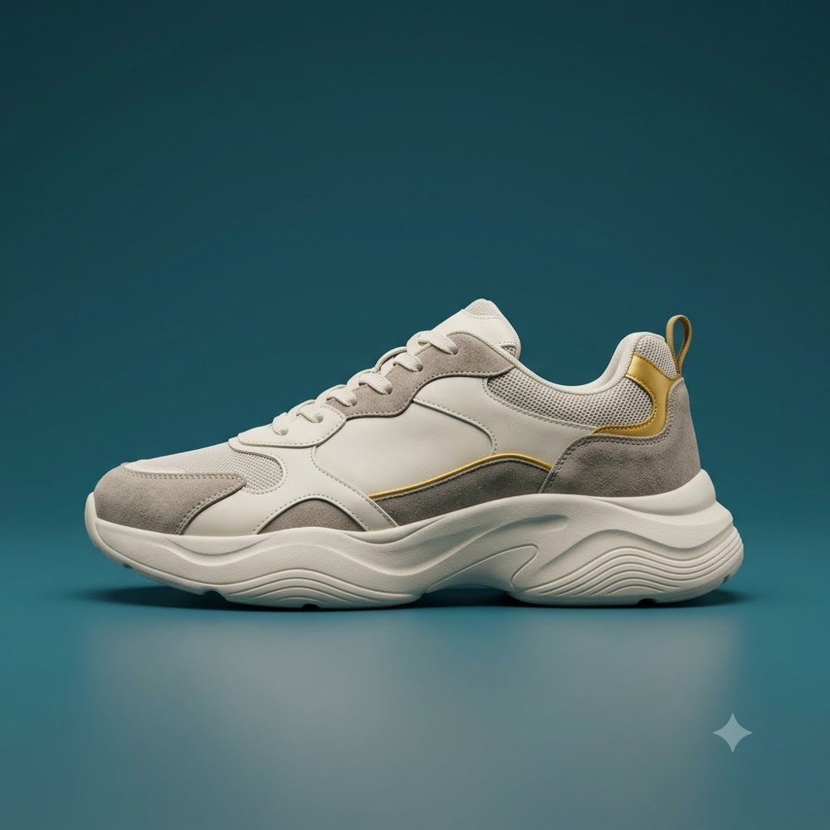
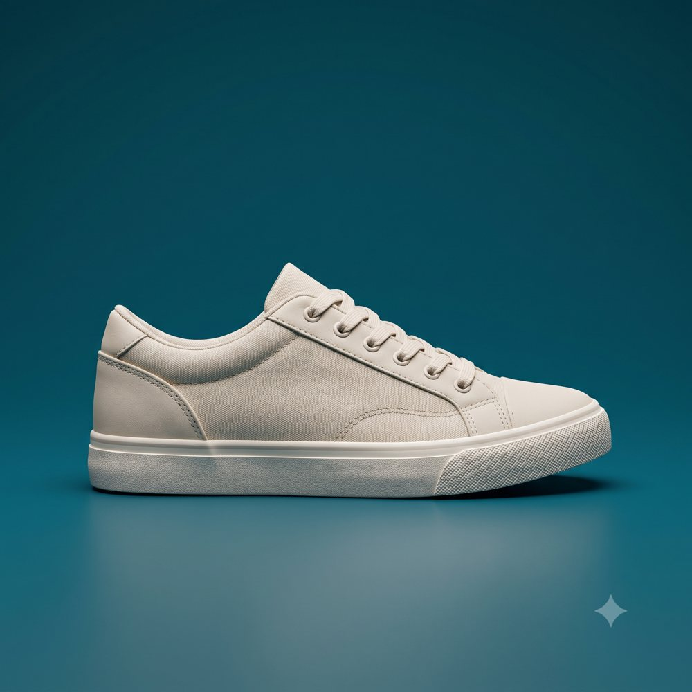
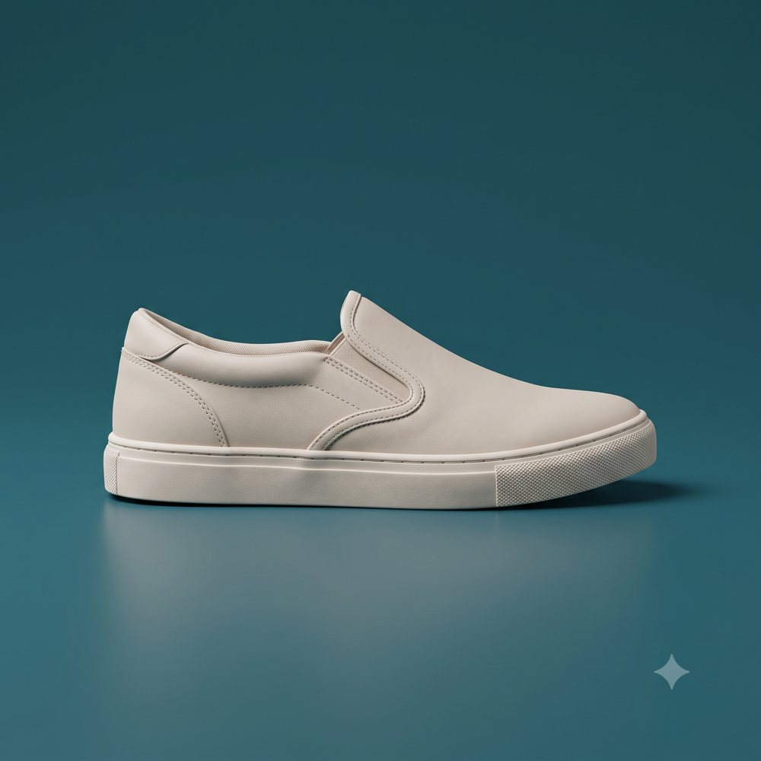
STEP 2 · SEGMENTS
Four segments — by why people buy.
Performance Loyalists
Sneaker Culture & Hype Buyers
6.5%
3.8%
TRAINING & HABIT
STATUS & SELF-EXPRESSION
Premium running-shoe purchase
Limited-release or collab purchase
Everyday Family Buyers
Athleisure & Comfort Buyers
14.2%
3.5%
DURABILITY & VALUE
ALL-DAY COMFORT
Mass-brand purchase, household with kids
Lifestyle sneakers for non-athletic wear
Each segment is a definition, already scored for everyone — no new models to build.

Slide 4
STEP 3 · THE MEDIA PLAN
Where to reach each segment.
1
Performance Loyalists
Fitness-app usage ~54% · Race / event participation ~18% · Sports-media ~41%
2
Sneaker Culture & Hype Buyers
Short-video & social apps ~71% · Sneaker-resale apps ~23% · Streetwear media ~20%
3
Everyday Family Buyers
Mass-retail circulars ~39% · Family & parenting media ~33% · Back-to-school buying ~27%
4
Athleisure & Comfort Buyers
Lifestyle & wellness content ~30% · All-day comfort need ~25% · Broad digital reach
Delivery anchors appended on the same 0–1 scale — the media plan, built into the file.

Slide 5

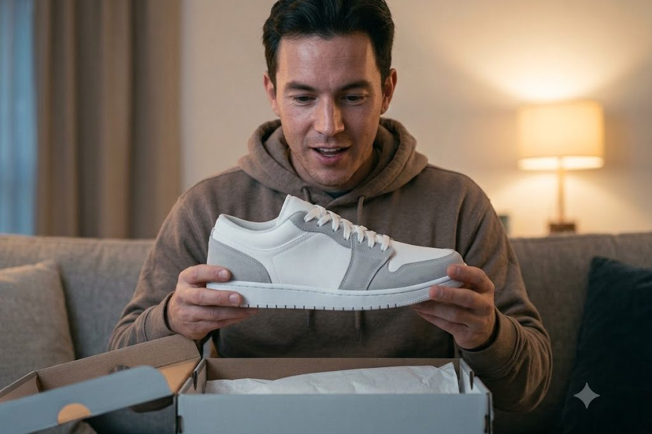


STEP 4 · THE CREATIVE BRIEF
Creative direction, per segment.
Performance Loyalists
Hype Buyers
Everyday Family Buyers
Athleisure & Comfort Buyers
“Motion photography, technical specs up front, race-season timing.”
“Bold collab storytelling, release-countdown urgency, drop-day timing.”
“Bright family-store scenes, practical value copy, back-to-school timing.”
“Soft everyday-wear imagery, errands-to-evening context, comfort-first copy.”
Illustrative creative, art-directed by a team from each brief — not produced by the platform.

Slide 6
STEP 5 · THE CATEGORY
The market, mapped to your segments.
52%
Mass-market conglomerates
→ Everyday / Athleisure
18%
Value & family
→ Everyday Family
13%
Running specialty
→ Performance Loyalists
12%
Heritage lifestyle & streetwear
→ Hype Buyers
5%
Premium niche
→ Athleisure, higher-margin
Conquesting targets identified — a competitor's customers are one request away.

Slide 7
THE DELIVERABLE
One file. The whole plan inside.
Most audience data answers one question: who qualifies. A super audience answers the next four — for every individual person.
Audience
Email
Streaming
Social
Direct mail
Best offer
Motivation
Switch
0.91
0.34
0.72
0.55
0.18
Trade-up
Habit
Rival A
0.88
0.61
0.29
0.80
0.42
Bundle
Status
Rival B
0.79
0.22
0.66
0.48
0.71
Value
Family
Rival C
Each person scored for how to reach them, what to offer, why they buy, and which competitor might tempt them away — one file does the job of the audience list, the media plan, and the creative brief.
Example rows; scores illustrative. Every column is a real, orderable score on the same 0–1 scale.
Delivered as a scored file — plus this ready-to-present deck, built from the same scores.

Slide 8
Seven words in.
A full plan out.
One afternoon. Zero code. Zero models trained.
Point Intelafy at the data you already license, and a plain sentence comes back as a scored audience, a media plan, and a creative brief — together.
The measurement engine behind the audience.
Illustrative example; company and figures anonymized. © 2026 Intelafy.

